Slide 1
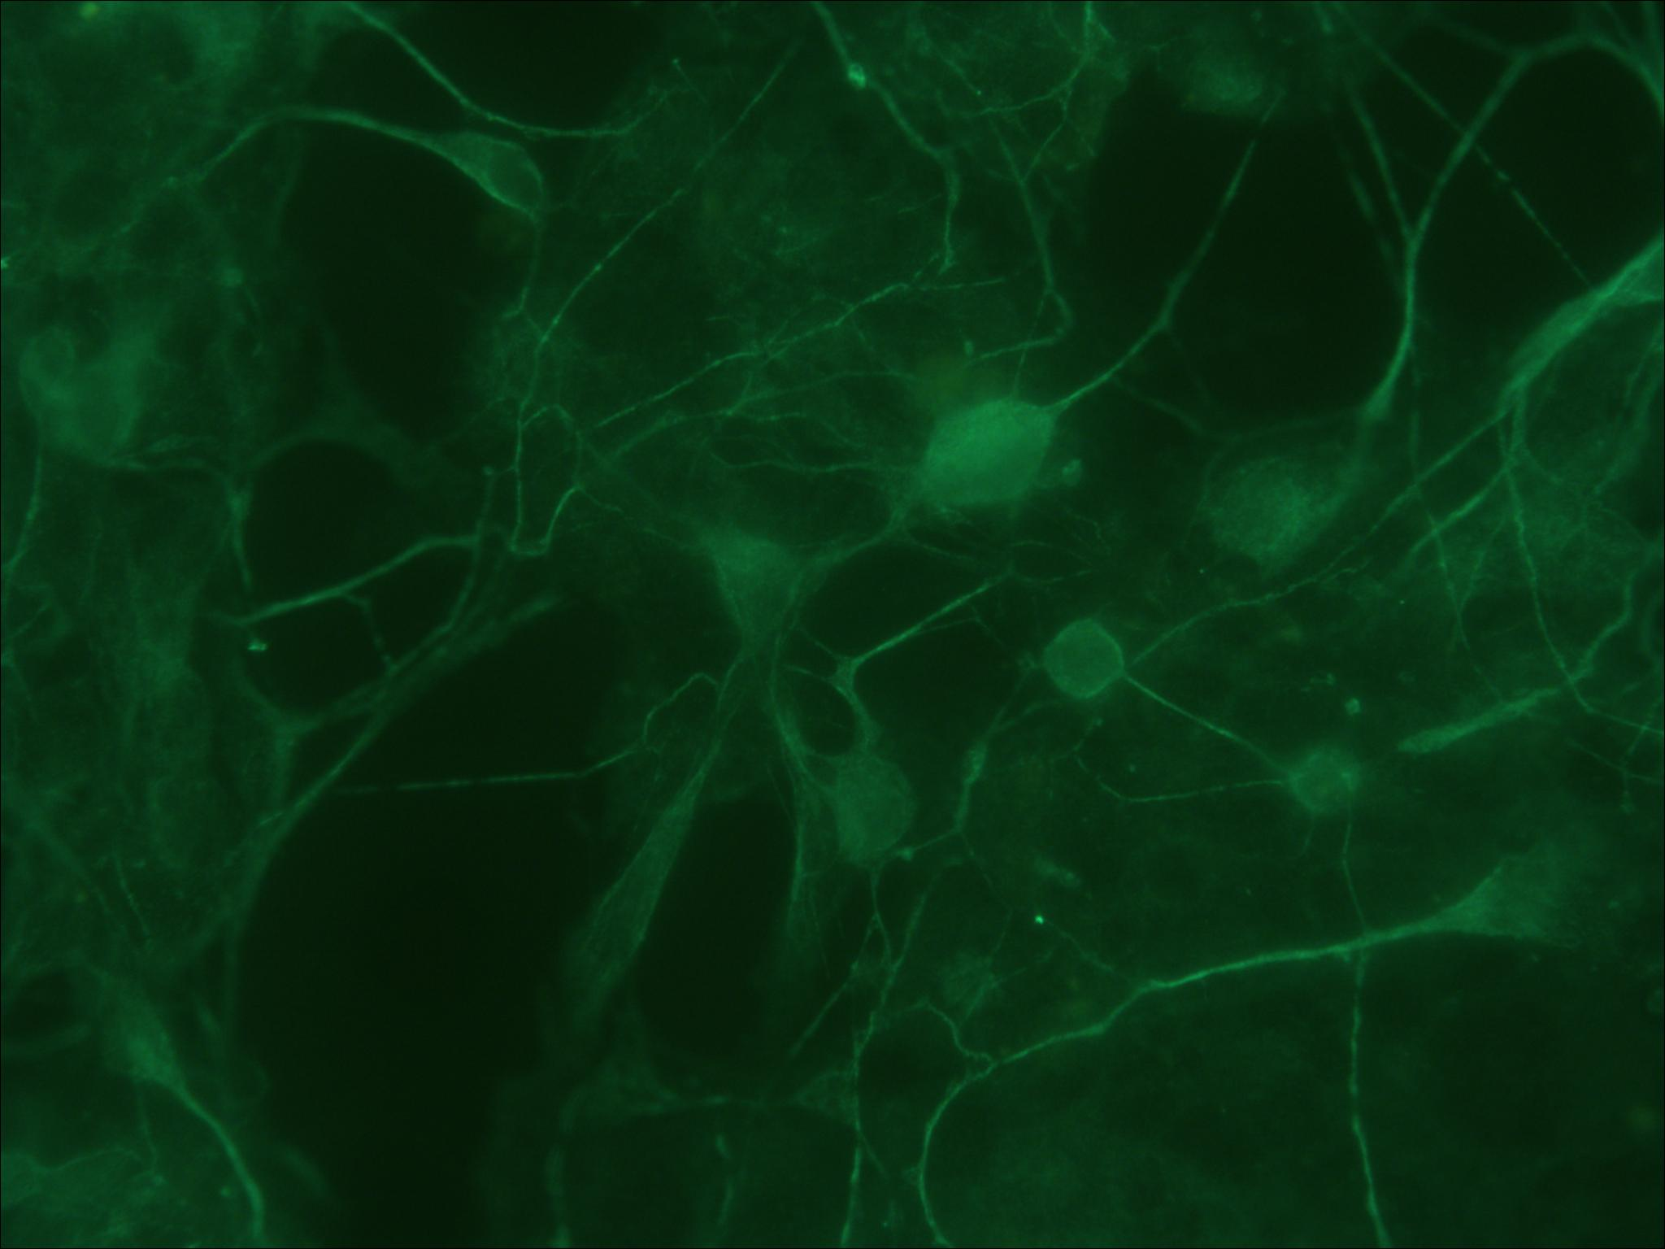
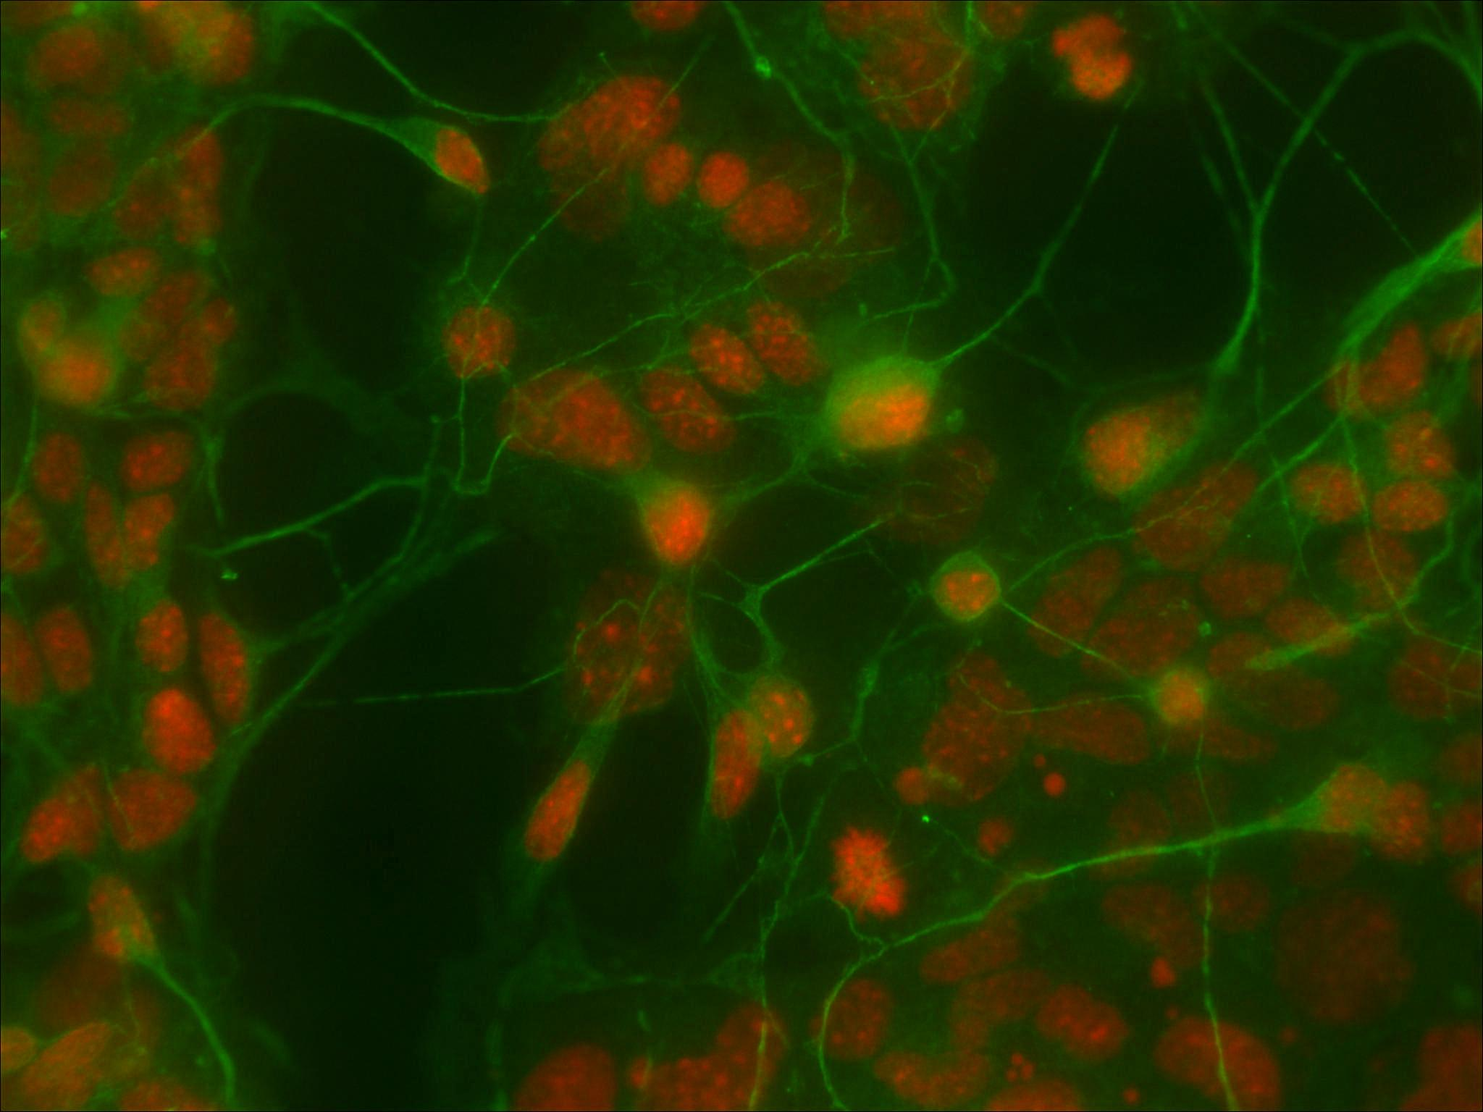
Serotonergic P19s
Tubulin stain
Tubulin + DAPI

Slide 2
motivations
P19 + retinoic acid = neurons
  What kind & how?
    glutamergic
    cholinergic
Differentiating serotonergic neurons
  dopaminergic neurons
  other cell lines

Slide 3
Plans
Cloning & transduction
  Gata2
  Mash1
  Foxa2 (forkhead transcription factor)
Neural differentiation
Immunocytochemistry
  anti-5HT
anti-neurofilament
Notes:
Gata2 - makes a protein called GATA binding proein 2, a transcription factors
Gata2 specifies serotonergic neurons downstream of sonic hedgehog
Ascl1/Mash1 is required for the development of central serotonergic neurons.
Gata2, unlike Gata3, is required for the differentiation of all 5-HT neurons and activates expression of Lmx1b and Pet1 at least in r1 [5, 6]. G
prevents expression of Phox2b and motor neuron differentiation, while delayed expression of Foxa2 in r2–r3 and r5–r7 down regu- lates Phox2b expression and allows the switch from motor neuron to 5-HT neuron differentiation [7].

Slide 4
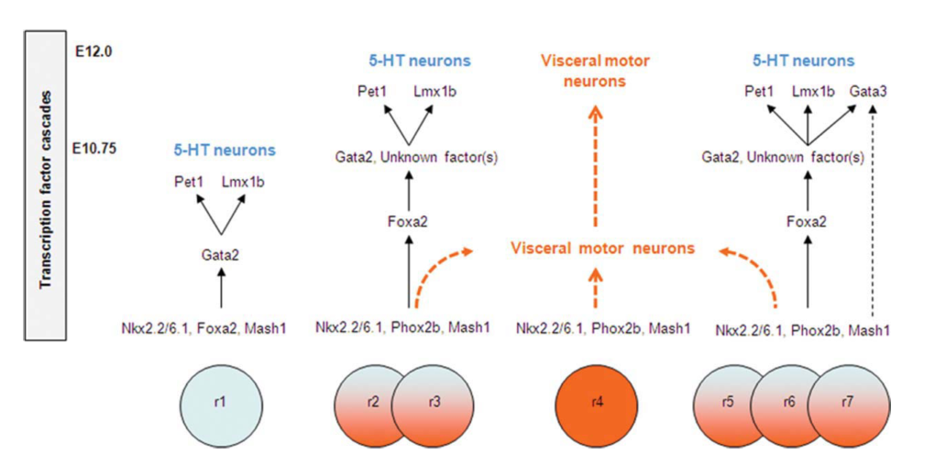
transcription factor cascades and growth factors
5-HT: 5-hydroxytryptamine;
r1–r3: rostral 5-HT neuron group
r5–r7: caudal 5-HT neuron group.

Slide 5
(some) literature
1. Hendricks, T. J. et al. Pet-1 ETS gene plays a critical role in 5-HT neuron development and is required for normal anxiety-like and aggressive behavior. Neuron 37, 233–47 (2003).
2. Jacob, J. et al. Transcriptional repression coordinates the temporal switch from motor to serotonergic neurogenesis. Nature neuroscience 10, 1433–9 (2007).
3. Pattyn, A. et al. Ascl1/Mash1 is required for the development of central serotonergic neurons. Nature neuroscience 7, 589–95 (2004).
4. Craven, S. E. et al. Gata2 specifies serotonergic neurons downstream of sonic hedgehog. Development (Cambridge, England) 131, 1165–73 (2004).
5. Nefzger, C. M., Haynes, J. M. & Pouton, C. W. Directed expression of Gata2, Mash1, and Foxa2 synergize to induce the serotonergic neuron phenotype during in vitro differentiation of embryonic stem cells. Stem cells (Dayton, Ohio) 29, 928–39 (2011).
6. Rodrı, A., Kim, J., Auerbach, J. M., Bankiewicz, K. & Mckay, R. Dopamine neurons derived from embryonic stem cells function in an animal model of Parkinson ’ s disease. (2002).
7. MacPherson, P. a, Jones, S., Pawson, P. a, Marshall, K. C. & McBurney, M. W. P19 cells differentiate into glutamatergic and glutamate-responsive neurons in vitro. Neuroscience 80, 487–99 (1997).
8. Bell, J. C. & Craig, J. Differentiation and Maturation Neurons in Cell Culture of Embryonal Carcinoma-Derived Neurons in Cell Culture. The Journal of neuroscience 8, 1063–1073 (1988).
9. Hynes, M. & Rosenthal, A. Specification of dopaminergic and serotonergic neurons in the vertebrate CNS. Current opinion in neurobiology 9, 26–36 (1999).

